Slide 1
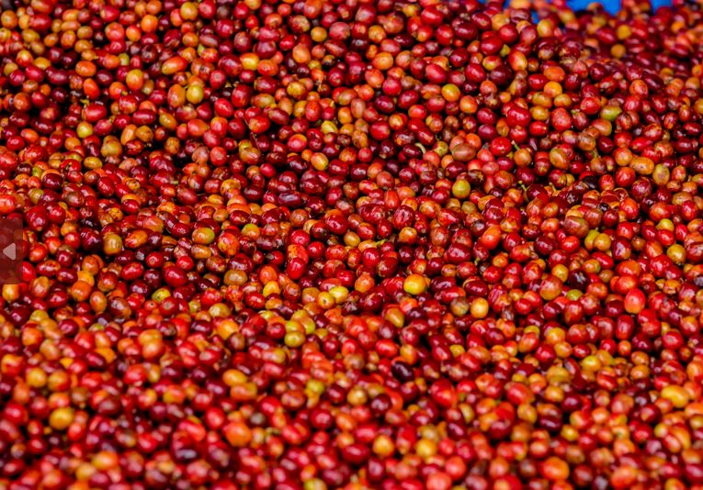
KOAKAKA
www.shared-interest.com
Notes:
Image shows coffee beans after selection
In the southern province of Rwanda, three coffee associations in the Karama, Kinyamakara and Rukondo communities came together in 1999 with the purpose of strengthening their position in the local coffee sector and increasing their access to international markets. This union was later formalised in 2002 and named KOAKAKA (Koperative y’ abahinzi ba Kawa Karaba, meaning ‘Co-operative of Coffee Growers of Karaba’). Their coffee is grown on the edge of the Nyungwe rainforest, a protected natural reserve that is also known as the ‘green lung’ of the region.
Starting with 867 farmers, the co-operative now has 1,316 members (297 women) and each farmer must have a minimum of 300 trees. Almost all members are small-scale farmers, each owning approximately a quarter of a hectare of land where they grow on average 400 coffee trees, together with other crops such as bananas, corn and beans. These crops provide food for the household and any surplus is sold on the local market for additional income.
Shared Interest was the first international finance provider to support KOAKAKA in 2013 with a Commercial Order Export Credit (COEC) facility of USD 200k in order to prefinance their coffee harvest. Before securing this facility, KOAKAKA faced challenges in paying farmers for their coffee each season. They relied on their local bank, but the funds often arrived late, leaving the co-operative unable to pay for the entire harvest. The facility enabled KOAKAKA to begin purchasing all of the coffee from their members, increasing their production volume as well as member loyalty.
In 2014, Shared Interest provided KOAKAKA with a Term Loan of USD 27k to purchase a truck, which reduced their production costs, as they previously had to hire vehicles to transport their coffee between the two washing stations.

Slide 2
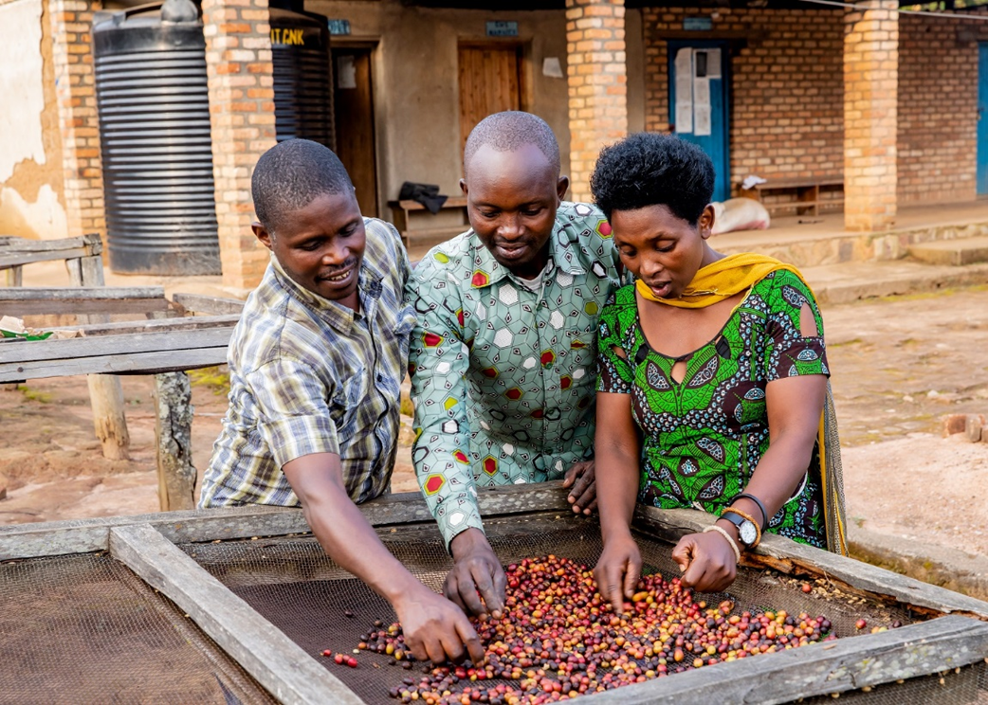
KOAKAKA
www.shared-interest.com
Notes:
Image shows three Coffee producers working together Marcel Myasiro, Etienne Nkurunziza and Marie Claire Munganyinka
Etienne Nkurunziza (pictured in the middle above)
Etienne Nkurunziza is a coffee farmer and member of KOAKAKA. Whilst Etienne has been a member of KOAKAKA since 2007, he has been a coffee farmer since he was 15 years old. He started on a small coffee plantation of less than a hectare, given to him by his parents. When he left school three years later, he joined KOAKAKA cooperative. In addition to coffee, Etienne also farms beans and maize. These provide food for the household and generate additional income as the majority he sells on the local market.
He explained how his weekly farm activities are determined by the season and the weather: “Every Tuesday, I have to visit my field, despite everything else that might be going on. I have to visit the field to assess what is going on and see if there is any problem. I plan other activities on other days. “Depending on the timing in the season, I plan activities that I will do every day. If it’s mulching day, I have to identify a place to get the mulch from, and I take it to the field. If it is manure, I have to carry it that day on the field depending on the month because I can’t bring manure to the field every day. I apply it during the wet season so that my manure doesn’t dry up. On every field visit, I assess which activities are required as time passes. That’s how I plan it, depending on months and seasons.”
Etienne explained that KOAKAKA gave him financial stability by providing him with a market for his coffee. He told us about the impact of this stability on his life: “A lot has changed. I can start with my livelihoods. I was able to build a house in the village. I was able to get married. Another benefit from KOAKAKA was access to agriculture training and other general knowledge that leads to one’s development.

